Slide 1






A Capture-Recapture Model with Temporary Emigration for Estimating Population Size from Incomplete Registers
${\text{Lucy} \text{Brown}}^{1}$: lyb3@kent.ac.uk
$${\text{Eleni} \text{Matechou}}^{1}$$
$${\text{Bruno} \text{Santos}}^{2}$$
$${\text{Eleonora} \text{Mussino}}^{3}$$
1 University of Kent, UK
2 University of Lisbon, Portugal
3 Stockholm University, Sweden

Slide 2

Motivating Case Study
[1] Andrea Monti, Sven Drefahl, Eleonora Mussino, and Juho Härkönen. Over-coverage in population registers leads to bias in demographic estimates. Population Studies, 74(3):451–469, 2020
[2] Eleonora Mussino, Bruno Santos, Andrea Monti, Eleni Matechou, and Sven Drefahl. Multiple systems estimation for studying over-coverage and its heterogeneity in population registers. Quality & Quantity, pages 1–24, 2023
Overcoverage:
Due to imperfect emigration and/or death registration
Leads to serious bias in population estimates
Negatively influences policy-making and research
Overcoverage Estimation:
Existing approache$s^{\left[1\right][2]}$ in Sweden rely on multiple systems estimation (MSE) and only consider annual snapshots of the register data
Instead, we have employed a longitudinal approach, following individuals, and hence registers, over different years

Slide 3
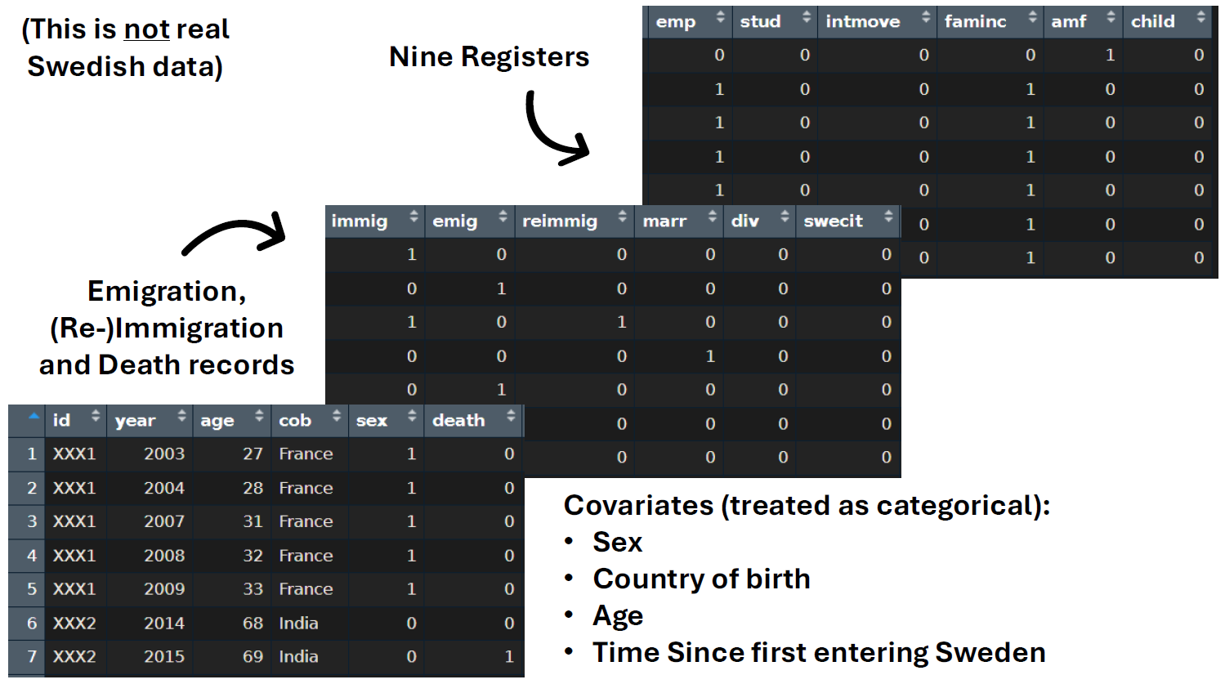
Swedish Register Data
Provided by the Swedish National Institute of Statistics (Statistics Sweden - SCB)
All foreign-born residents who first entered Sweden between the years 2003 and 2016 as adults
(This is not real data)

Slide 4
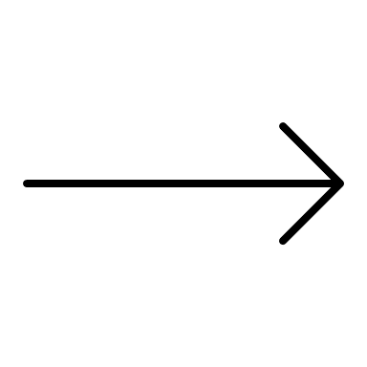

Observations
An individual is observed on some combination of R registers, on which they can be observed (1) or not observed (0), i.e. 2 possible outcomes for each register
$⟹ 2^{R}$ register combinations
Example Person #1
(0,1)
(1,1)
(0,0)
(0,0)
(0,0)
Death recorded
Dead
alive
alive
dead
dead
dead
Example Person #2
(1,1)
(0,1)
(0,0)
(0,0)
(1,0)
Have they been missed or are they not there anymore?
alive
alive
?
?
alive

Slide 5
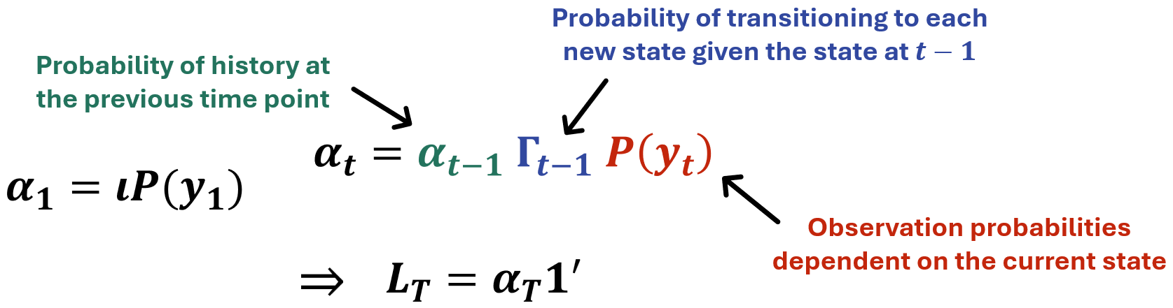

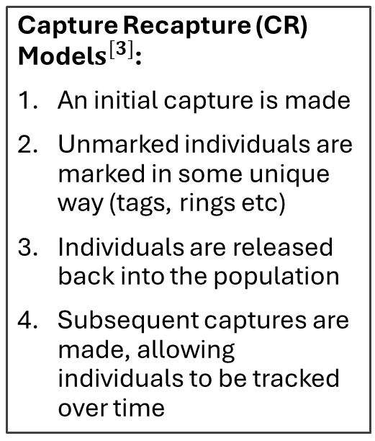
Capture-Recapture & HMM Formulation
Capture Recapture (CR) Model$s^{[3]}$:
An initial capture is made
Unmarked individuals are marked in some unique way (tags, rings etc)
Individuals are released back into the population
Subsequent captures are made, allowing individuals to be tracked over time
CR models are commonly used in ecology to estimate population size for wild animals
An individual’s true state is unobservable (latent)
Hidden Markov model (HMM) formulation marginalises over the latent state to calculate the marginal likelihood
This iterative method is very efficient and allows latent states to be inferred
$$δ P(y_{1})$$
[3] Kenneth H. Pollock. Capture-recapture models. Journal of the American Statistical Association, 95(449):293–296, 2000. ISSN 01621459, 1537274X. URLhttp://www.jstor.org/stable/2669550

Slide 6





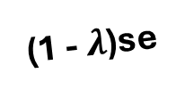
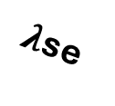



States
died in the country
1
1 - s
1 - s
s(1 – e)
1
(1 - $λ$)se
outside the country and not de-registered
in the country and alive
1 - s
died outside the country
si
(1 - $λ$)se
$λ$se
s(1 – i)
s(1 – e)
1 - s
si
outside the country and de-registered
e: emigration
i: re-immigration
$λ$: de-registration
s: survival
just returned and re-registered
$λ$se
s(1 – i)

Slide 7
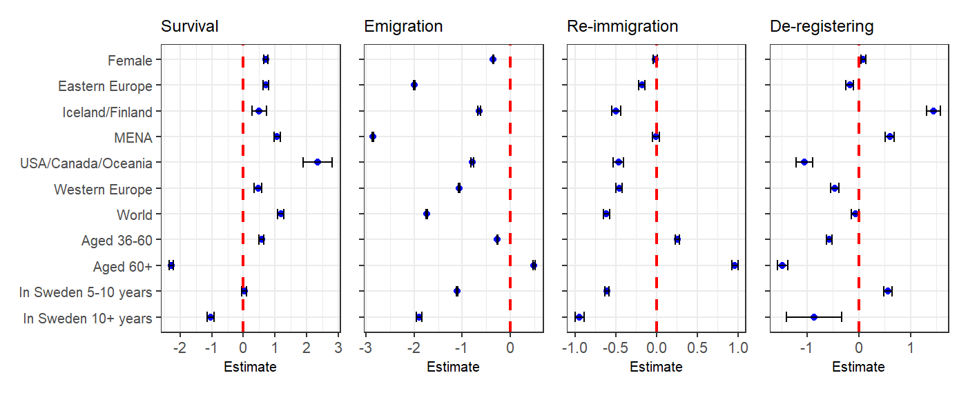

De-registering Probability
Baseline: men aged 18-35, born in Denmark/Norway who first entered Sweden less than 5 years ago
logit$\left(λ\right)=−0.332 ⇒ λ=0.418$
Women aged 18-35, born in Iceland/Finland who first entered Sweden 5-10 years ago
logit$\left(λ\right)=−0.332+0.088 +1.452 +0.568$
$⇒ λ=0.855$
Men aged 60+, born in USA/Canada/Oceania who first entered Sweden 10+ years ago
logit$\left(λ\right)=−0.332 −1.053 −1.474 −0.865$
$⇒ λ=0.024$
7

Slide 8
Baseline: men aged 18-35, born in Denmark/Norway who first entered Sweden less than 5 years ago
Survival: 0.996 (0.996, 0.997)
Emigration: 0.395 (0.391, 0.398)
Re-immigration: 0.053 (0.052, 0.055)

Slide 9
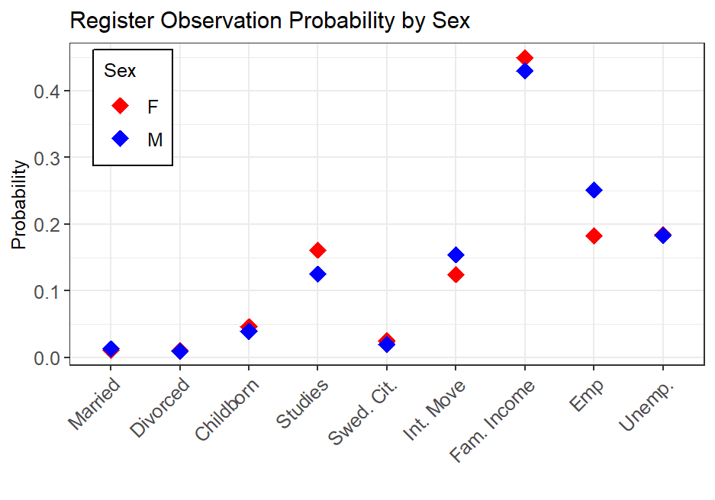
We obtain observation probability estimates for each register and each combination of registers.
Probability of being unobserved:
Male: 0.0251
Female: 0.0220
Probability of being observed in at least one register:
Male: 0.9749
Female: 0.9780

Slide 10

Future Work
Experiment with methods to calculate population size estimates e.g. Viterbi Algorithm
Considering further extensions such as dependence between family units
Application to equivalent data from Norway, provided by Statistics Norway
  Additional complexity that checks are regularly done and individuals manually removed if not present in the country
Thank you for your attention!
Email: lyb3@kent.ac.uk

